Slide 1


Figure 1: Existing system
SKS
codes
Clinician
Old EHR
requests,
results
LabSys
Batch transfer
of data
Medication
codes
SKS
Patient
management
Figure 2: Vision for the new system
Double-line border:
The delivery
codes
F1. SKS
EHR system
Clinician
F3. Medica-
tion system
requests,
results
F2. LabSys
New external
systems
Double line:
The supplier integrates
Patient
management

Slide 2
Figure 3. Data model for the system
D5. Person
Person ID, Name . . .
Plus 12 more boxes
State, Start,
End, Name
D6. Admission
Name, Start time,
State (obs | valid | canceled | closed),
. . . recommendation
Consists of
D1. Diagnosis
D3. Service
Dotted box: Shared with external system
Start time, State ( . . .),
. . .
Diagnosis code, Name,
State (considered | . . .),
Description, Recommendation
D2. Diagnosis
Type
D4. Service
Type
Hierarchy
Hierarchy
Service code, Name,
State (. . .), . . .

Slide 3
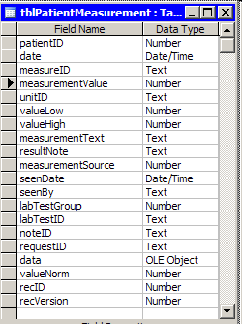
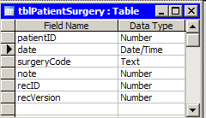
Figure 4. Present service tables

Slide 4
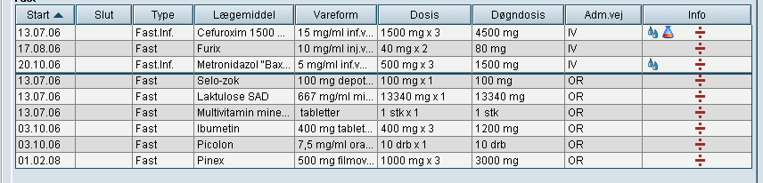
Figure 5. Present medication data
Start
End
Type
Medicine
Unit
Dosis
Daily dosis
Path
Info
Solid.Inf.
Solid
Solid.Inf.
Solid
Solid
Solid
Solid
Solid
Solid

Slide 5
Figure 6. Diagnosis states
Obs
Clinician
Canceled
Clinician
Clinician
any state
Automatic
(20 years)
Clinician
Valid
Closed
Clinician

Slide 6
Figure 7. LabSys service states and messages
Clinician
Ordered
LabConfirm
Confirmed
Clinician
Started
LabRequest
Clinician
LabSample
LabConfirm
LabSys
changed
Clinician
Completed
LabRequest
Doctor
any state
Canceled
any state
Assessed
LabCancel
Clinician
Automatic
(20 years)

Slide 7
Figure 8. Context diagram
codes
F1. SKS
EHR system
Clinician
F3. Medica-
tion system
F2. LabSys
requests,
results
F10. New external
systems
Double line:
The supplier integrates
Patient
management

