Slide 1
The gestalt law of parallel movement
The book by Lauesen, User Interface Design, illustrates many of the gestalt laws, but cannot illustrate the law of parallel movement: Things that move in parallel, are perceived as belonging together. This file gives a striking illustration of the law. Show the slides in full-screen mode.
The first slide shows random "raindrops". When you click or hit a next key, a cross gestalt moves up. As soon as it stops, the cross disappears. No gestalt is visible. The movement made it visible because the drops move in parallel. Click again, and the cros moves away.
The next slide has a similar trick with an elephant. Notice that now the gestalt is visible for a few seconds after movement stops. The vision-center models in section 3.4 can explain this difference. How?
The file also has slides with backgrounds and figures separately. In the old days, we printed them on transparencies. On a projector, we put figure and background on top of each other. We could then move them by hand in many speeds and paths. The effect was mcuh better than the computer version.
© Lauesen, 2017

Slide 2
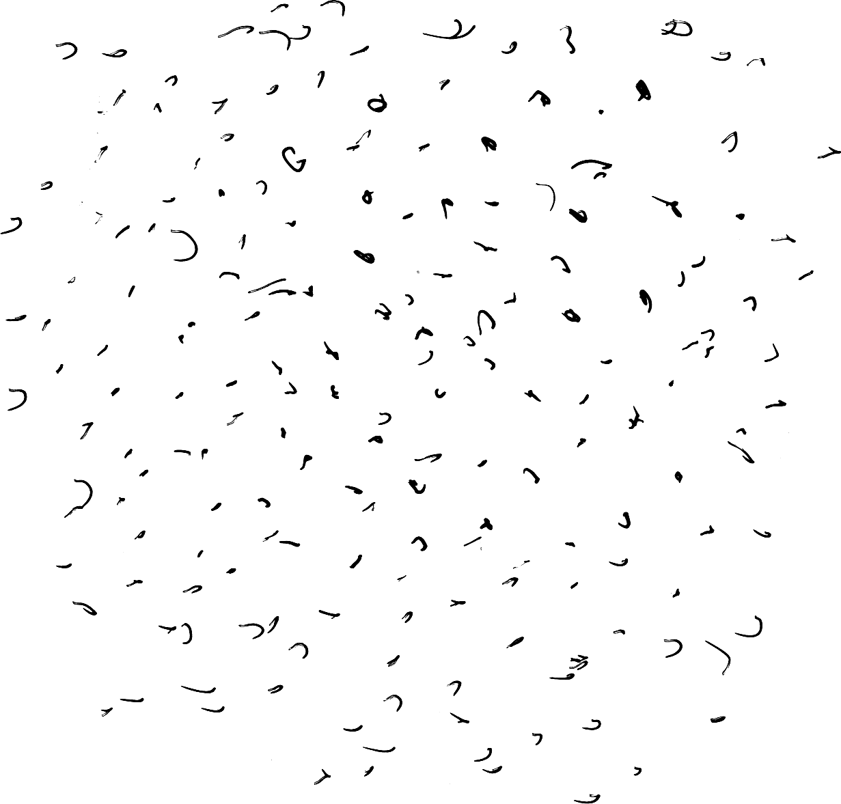
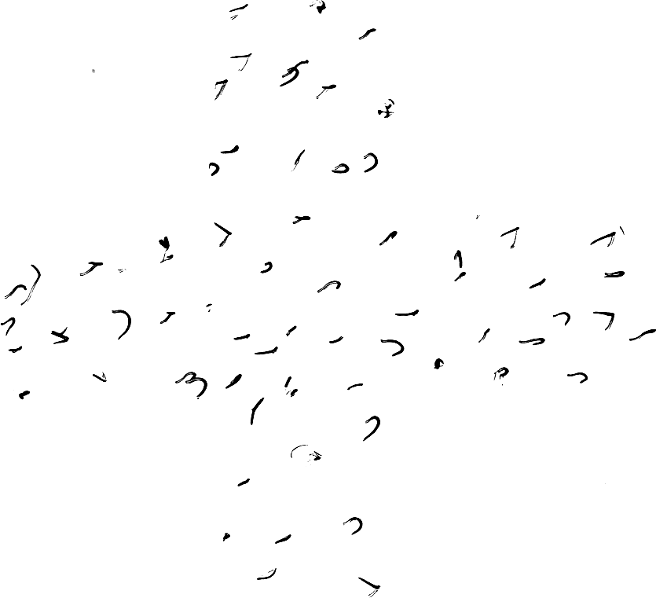
Cross & Background
© Lauesen, 2017

Slide 3
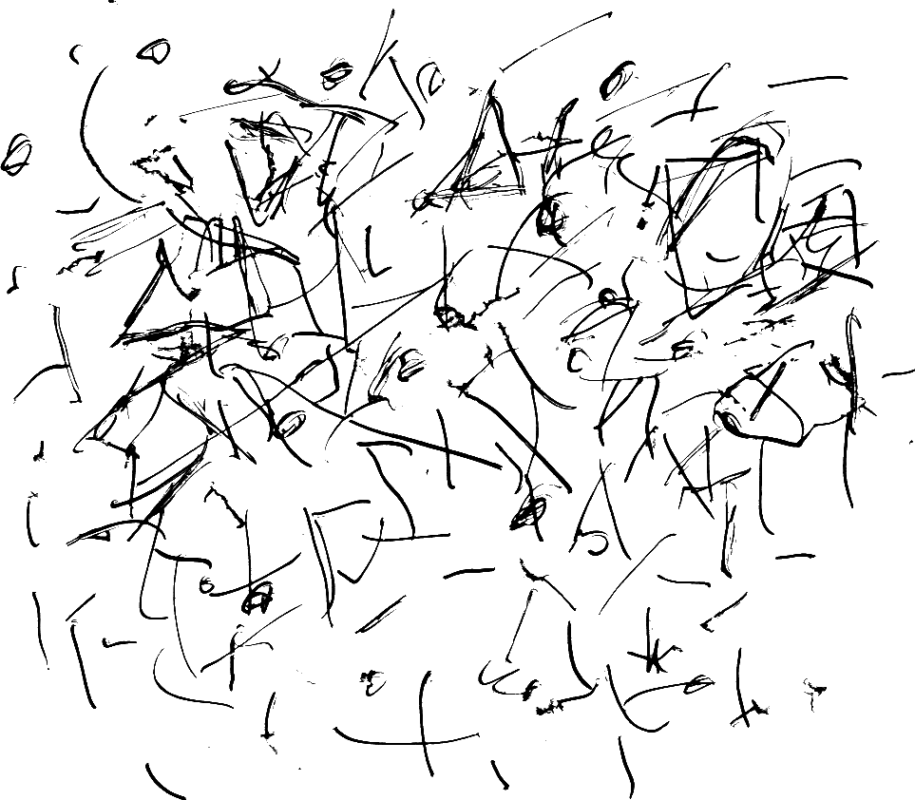
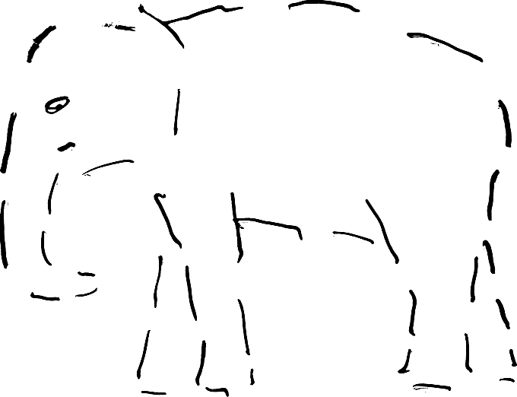
Elephant & Background
© Lauesen, 2017

Slide 4
Cross
© Lauesen, 2017

Slide 5
CrossBackground
© Lauesen, 2017

Slide 6
Elephant
© Lauesen, 2017

Slide 7
ElephantBackground
© Lauesen, 2017

