Slide 1
User interface design
A software engineering perspective
The Virtual Window method
This is a mini-course in systematic user interface design. Go through the course on your own. It is not intended for presentation to a large audience. Plan to spend 30 focused minutes.
Use the spacebar, arrow keys or PgUp/PgDn to go through the course. In a few places you can take a detour by clicking on hyper-links. You may print out the slides for reference (change the file suffix from “pps” to “ppt”, open the file and print all slides).
See teaching material, case studies, etc. on http://www.itu.dk/people/slauesen
The course is based on the book “User Interface Design” by Soren Lauesen, Addison-Wesley, 2005. The book describes the design approach in much more detail, explaining also when things don’t work exactly as this mini-course says. The mini-course often refers to chapters of the book. We have developed the design approach over several years. It combines software engineering principles, usability principles and psychology. It has been highly successful for Web-design, traditional applications, and mobile applications.
© Soren Lauesen, IT-University of Copenhagen, February 2009, slauesen@itu.dk

Slide 2
2. Good and bad user interfaces
see, edit
create, delete
It is easy to make a user interface.
Just allow the user to see, edit, create or delete any data in the database.
Unfortunately, it is hard to make a good user interface. By the way, what is a good user interface?
Database
One way of defining “good” is “few usability problems”. Here are some typical usability problems.
Examples of usability problems:
The system works correctly, but the user:
P1. Cannot figure out how to start the search.
Finally finds out to use F10.
P2. Believes he has completed the task, but forgot to push Update.
P3. Sees the discount code field, but cannot figure out which code to use.
P4. Says it is crazy to use six screens to fill in ten fields.
P5. Wants to print a list of discount codes, but the system cannot do it.
Our systematic design approach develops the user interface in several steps. For each step, we use various techniques to eliminate usability problems.
Experience has shown that it is crucial to design the data presentation very early - which screens should the system have and how should they show data? These data presentations are the Virtual Windows. The necessary functions, such as menu points and buttons are added later.
Chapter 1 of the book explains more about good user interfaces and how to measure the goodness.
Virtual windows are related to Wireframes. However, Virtual Windows stress realistic data. Wireframes don’t.

Slide 3
3. Example: A hotel system
We will show the design approach through an example: Design the user interface for a hotel reception system.
The system must support several tasks in the reception. We write them down as a task list. (Tasks are similar to "use cases" but describe what user and computer do together. One purpose of the design process is to specify exactly who does what.)
Task list
Book guest
Check in
Check out
Change room
Breakfast list &
other services
Data about
Guests
Rooms
Services
To support these tasks, the system has to store data about guests, rooms and services. We write it as some kind of data description.
The task list and the data list are the basis for our design. Chapter 5 of the book shows ways to describe tasks and data in more detail. Chapters 15 and 16 explain about the analysis behind such descriptions.
More on task descriptions
More on data descriptions

Slide 4
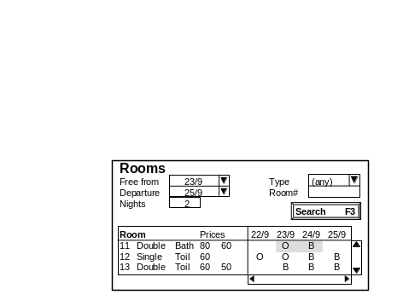
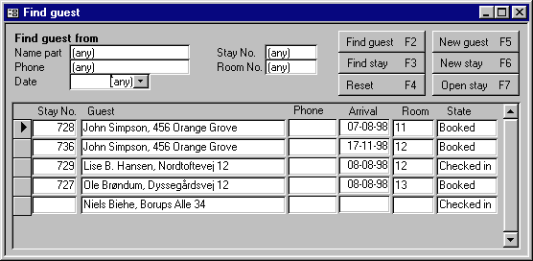
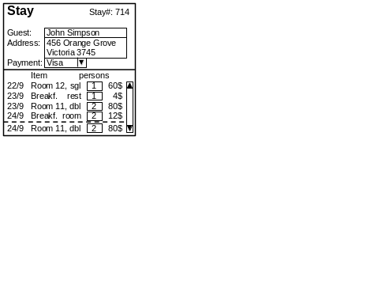
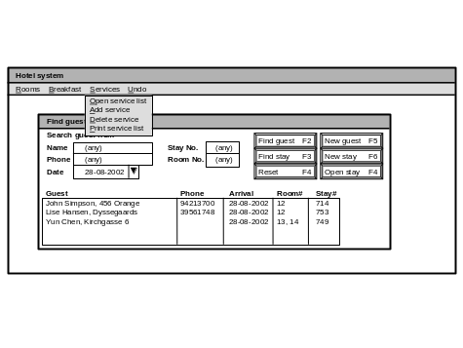
4. Virtual Window method - overview of the entire process
1 Based on data and tasks, design the graphical data
presentation. Reuse from task to task whenever possible.
Data model
Task descriptions
Provide many of the test cases
Virtual windows =
graphical data presentation
Understandability testing - iterate
5 Program and test the system
Usability testing - iterate
Search, New booking
Check in, Print
4 Visualize the functions and make a mockup
2 Use tasks again to add the "buttons" needed if we had a giant screen
3 Add navigation "buttons"
needed on a real screen
Open, Close
Goto, Back

Slide 5
5. Virtual windows, plan
When many guests are booked, the user should imagine that there is a whole pile of Stay windows. The Rooms window doesn’t belong to any particular Stay, so we would confuse the user if we combined Stay and Rooms into one window.
A Stay and a Rooms window seem to be sufficient for booking.
4
Tasks: Virtual windows:
Stay
name, address
period
booked rooms
Rooms
prices, type
status, date
Check-in
Change room
Next we look at the check-in task. Which data does the user need here? If the guest hasn’t booked in advance, the user needs the same as for booking: the Rooms window and a new Stay window. The functions he uses are a bit different, but the data are the same.
If the guest has booked, the user needs to find the proper Stay from the pile. For the moment we will ignore the details of how he finds this Stay. So it seems that we don’t need any new windows for check-in.
The first part of the design is a plan for the user interface screens: how many screens and which data do they show? At the beginning we don’t care about buttons and other functions on the screens. Our first screen versions are what we call Virtual Windows. We make the plan by looking at the tasks one by one.
5
1
Let us look at the booking task. What data would the user need to see to carry out this task? He has to see whether there are free rooms when the guest needs them, the prices of the rooms, etc. We plan to put this data into some kind of Rooms window.
2
6
The next task is Change room. The guest wants to move to another room. Again, the user can handle it by means of the above two windows.
The user also needs to record the name and address of the guest, the room he has booked, etc. We plan to put it into some kind of Stay window that shows the guest’s stay.
3

Slide 6
6. Virtual windows, plan
2 This means that the user may see too much data during the booking task, but it doesn’t matter right now. It is more important to have few windows to help the user form a good mental model of what goes on.
Tasks: Virtual windows:
Book
Stay
name, address
period
booked rooms
Rooms
prices, type
status, date
Check-in
Change room
3 The last task on our list is Record breakfast & Services. Do we need a new window for this? In principle no. The user can just find the right Stay window and with appropriate functions record the service there.
However, in many hotels, the breakfast restaurant has a list with all the room numbers. Staff write on it which rooms got which breakfast. Entering this long list by finding one room at a time is too cumbersome. We need a special window - a Breakfast list for each day.
Checkout
bednights, price
servings, price
Checkout
bednights, price
servings, price
Record
breakfast
& Services
Breakfast list
date
room#, type, servings
. . .
1
Check-out is a more interesting task. Again the user needs to find the guest’s stay, but he needs more data than before: The services the guest has got, the tax calculation, etc.
Should we make new virtual windows for this as the figure suggests? No, a basic design rule says: don’t make many windows, but reuse those you have. So instead we extend the “old” Stay windows with the price stuff.
4 This solution is very efficient to the user, but may also be confusing because the user now sees the service data in two places: in the Stay window and in the Breakfast list. Is it the same data - or must he do something to transfer it from one to the other?
This is an example of the trade-off between efficiency and understandability that we sometimes have to make. Efficiency won in this case.

Slide 7
7. Virtual windows, plan
1 By now we have virtual windows for handling all the tasks on our list. But how can we be sure that our list is complete? There are many checks we can make. One of them is to see whether the user can change all data in our system.
A cursory check reveals that there is no way to change service prices. We can only see the service prices in the Stay windows. But changing the price there would be strange.
We need a new task, Price change, and a new window with service prices.
Tasks: Virtual windows:
Book
Stay
name, address
period
booked rooms
Rooms
prices, type
status, date
Check-in
Change room
Checkout
bednights, price
servings, price
Record
breakfast
& services
Breakfast list
date
room#, type, servings
. . .
2 During the price change task, the user should also be able to change room prices. Can he do this? Yes, the Rooms window has the room prices. So we can just let the Price-change task access the Rooms window too.
Price change
Service prices
type, price
Rooms
prices, type
status, date
3 Chapter 6 of the book explains more about choosing the right virtual windows, checking that we got the right data, etc.
From an object-oriented perspective, the virtual windows are the objects the user should imagine - the user’s static class model. Later in the design process, we add operations (methods) to these objects.

Slide 8
8. Virtual windows, graphical version
2 We now see that the space for name and address is much too small.
Further, the detailed items for the stay show a slightly unusual situation: A guest checks in to a single room and gets breakfast in the restaurant. The next day he moves to a double room and gets two breakfasts in the room. Below the dotted line we have shown that he has booked the room one more day. This is shown as one stay, but is it really two? It is important to review such issues with an expert user. Virtual windows with realistic data allow us to do this.
John Simpson
456 Orange Grove
Victoria 3745
Visa
Stay Stay#: 714
Guest:
Address:
Payment:
Breakfast 9/8
In In
R# rest room
11 2
12 1
13 1 1
, sgl 1 60
rest 1 4
8/8 Room 11, dbl 2 80
9/8 Breakf. room 2 12
9/8 Room 11, dbl 2 80
Item #pers
7/8 Room 12
8/8 Breakf.
Service charges
Breakf. rest. 4
Breakf. room 6
. . .
3 Here is the graphical version of the virtual breakfast window and the service charge window. All of these virtual windows are fairly easy to make with typical development tools.
Notice that there are no buttons, menus, etc. in the virtual windows. They are unimportant at this stage. We add them later. The virtual windows deal with data presentation - not with the functions.
1 The plan for the virtual windows may look convincing and logical, but is it realistic? Can the windows show realistic data and can the user understand the windows?
The only way to find out is to make a detailed graphical design. Here is an early Stay window in graphical form. Although it looks primitive it is close to what we could have on the real screen. We can to some extent test that users understand what it shows, and they may nod and say it looks alright.
But if we fill in realistic data, we suddenly understand much more.

Slide 9
9. Virtual windows, graphical version
1 Finally we have a graphical version of the virtual rooms window. We use a matrix form (like a spreadsheet). There is a line for each room and a column for each date. Occupied rooms are shown by O and booked rooms by B. We may need to show a long list of rooms and dates, so on the final window we would need scroll bars.
This window is hard to make with most development tools, particularly if we also want the user to mark cells in the matrix and book rooms this way.
John Simpson
456 Orange Grove
Victoria 3745
Visa
Stay Stay#: 714
Guest:
Address:
Payment:
Breakfast 9/8
In In
R# rest room
11 2
12 1
13 1 1
, sgl 1 60
rest 1 4
8/8 Room 11, dbl 2 80
9/8 Breakf. room 2 12
9/8 Room 11, dbl 2 80
Item #pers
7/8 Room 12
8/8 Breakf.
Service charges
Breakf. rest. 4
Breakf. room 6
. . .
2 How do we come up with good graphical designs? It is a creative art, but these principles help:
1 Look at standard ways to show data.
2 Use gestalt laws.
3 Try realistic and extreme data (e.g. typical work situations and extreme data volumes).
4 Know the development tools so that you
don’t come up with unrealistic designs.
The book explains more on this in Chapters 3 and 6.
Rooms Prices 7/8 8/8 9/8 10/8
11 Double, bath 80 60 O B
12 Single, toil 60 O O B B
13 Double, toil 60 50 B B B

Slide 10
10. Show tasks with data for cheking. Design search windows
Task: 1.2 Checkin
Start: A guest arrives.
Sub-tasks: Virtual windows:
1. Find room. Rooms.
Crit: type, period.
1a. No suitable room. Rooms.
Crit: period.
1b. Guest booked. FindGuest, Stay.
Crit: name, ...
2. Record guest Stay, Rooms.
as checked in.
. . .
1 When the user has to select data from a large data set, search criteria are usually needed. To identify these needs, we look closer at the tasks and check that the necessary data are available in the virtual windows. For Check-in it looks like this.
2 Look at sub-task 1, Find room. The user may have to choose among hundreds of rooms and select dates a year ahead. The table shows that search criteria such as the room type and the period for the stay are needed. We can conveniently add these criteria as fields to the Rooms window.
3 When we check in a guest who has booked already, the table shows that we need to see his Stay window. But first we must find him by name, phone number, arrival date, etc. We need a new virtual window for this, FindGuest. Here is a possible graphical design of it.
Find guest from Stay# (any)
Name (any) Room# (any)
Phone (any)
Date 28-08-2002
Guest Arrival Room# Stay#
John Simpson, 456 Orange 07-08-2001 12 714
Lise Hansen, Dyssegaards 08-08-2001 12 753
Yun Chen, Kirchgasse 6 08-08-2001 13, 14 749
Search F3
4 The designer couldn’t resist putting a Search button on the screen, but in principle, buttons belong to a later stage in the systematic design.

Slide 11
11. Checking the design so far
1 Until now the design has been driven by the designer’s understanding and logic. It is time to see whether users understand the virtual windows. Show a user the virtual windows one by one. Don’t explain what they show, but ask what the user believes they show, whether something is missing, etc. We call this an understandability test.
This shows ...
User
believes ...
Designer
Records
problems
2 For the rooms window, expert users told us that seasonal prices were missing. Some non-expert users thought that O (Occupied) in the matrix meant zero, meaning that the room was free - a bad mistake to make in a reception.
At this stage, it is cheap to repair such defects - even to redesign several virtual windows.
User
Guest
Stay
Room
RoomState
Service
ServiceType
3 We can also check the internal consistency of our design. Here is an example: a check that all relevant data in the database can be handled by the user through some virtual window (assuming reasonable functions).
C means that the data can be Created, R read, E edited, D deleted, and O that the user gets an overview of this data.
The last line shows what is missing: There is no window that can delete a guest, although his stays can be deleted. Further there is no overview window for many guests or many stays (the FindGuest window - added later - helps here.)
Database
Virt.
window
Stay CRE CRED R RE RED R
Rooms CREDO RE O
Breakfast R CREDO R
Service charges CREDO
Missing? DO O (C D)

Slide 12
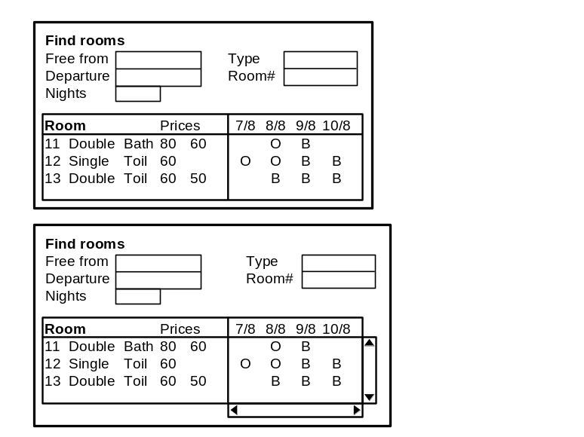
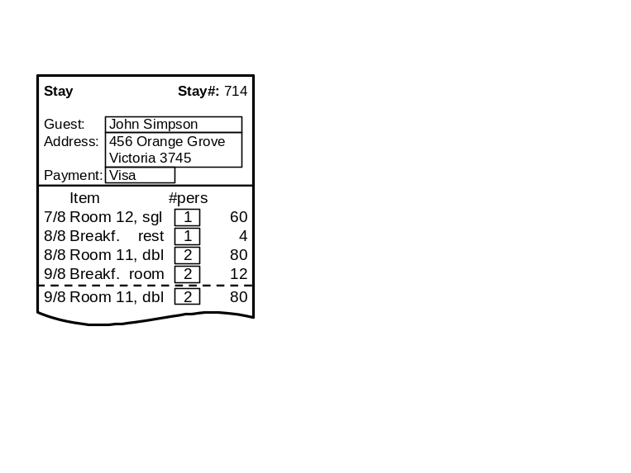
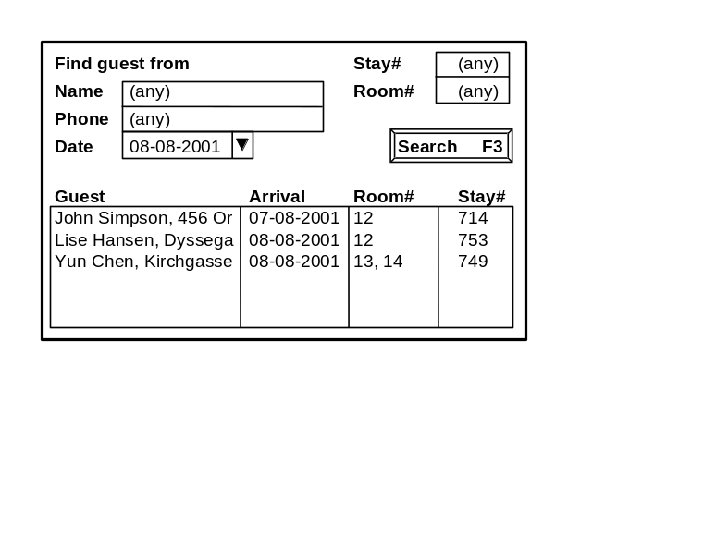
12. Function design, the booking task
1 The next part of the design is to add functions to the virtual windows. We place the virtual windows on a desk as if we had a giant screen. Then we look at the first task, Booking. Our desk would look like this.
3 We have now identified the first function and placed it on the Rooms window. We don’t record the data entry function for the search criteria, since it is obvious from the fields in the vindow.
Next the user would choose a room, so we also need a ChooseRoom function.
2 The first step of booking is to find free rooms. To do this, the user would use the Rooms window, fill in some search criteria, and activate a search function. We record it like this:
vwRooms:
FindRooms
ChooseRoom
vwStay:
Task: Booking
1. Find room
2. Record guest
2a. Regular guest
3. Record booking
3a. More rooms
4. Print confirmation
(optional)
vwFindGuest:

Slide 13
13. Function design, recording the guest
4 The next step of booking is to record the guest. The user might first check whether the guest is a regular. Here we need a FindGuest function in vwFindGuest.
6 NewStay will create a new version of vwStay and fill it with guest data. The user may review the data with the guest. We record this edit function since it is not so obvious.
5 If the user found the guest, he will select the guest (SelectLine) and activate a NewStay function. We now have three functions on vwFindGuest.
7 If the user didn’t find the guest, he uses another function, NewGuest. It also creates a new version of vwStay, but leaves the guest data empty for the user to fill in. Our function list now looks like this.
8 We have planned these functions according to a strict sequence of task steps, but the user need not follow this strict sequence.
In our case, he could for instance record the guest first and select a room for him later.
The functions don’t care about the sequence in this case.
vwRooms:
FindRooms
ChooseRoom
vwStay:
(EditData)
Task: Booking
1. Find room
2. Record guest
2a. Regular guest
3. Record booking
3a. More rooms
4. Print confirmation
(optional)
vwFindGuest:
FindGuest
SelectLine
NewStay
NewGuest

Slide 14
14. Function design, recording the booking
9 The next step of the booking task is to record the booking. We need a Book function and it seems convenient to put it on vwStay.
11 While the previous functions didn’t care about the step sequence, Book does. It requires that a room and a stay are selected. What is selected first doesn’t matter, however. Book also makes the real thing: It records the guest data in the database and changes the room state to booked for the stay period.
During the design we record such rules and what each function does in the form of mini-specs. Here is part of the mini-spec for Book.
10 However, if the user first recorded the guest data and next found a room, it might be convenient to have the Book function on vwRooms. Why not have it in both places? Let us plan for this.
12 Record booking has a variant: The guest may want more rooms. Which new functions are needed for this?
vwRooms:
FindRooms
ChooseRoom
Book?
Book
vwStay:
(EditData)
Mini-spec: Book. One or more rooms must
be selected and guest data adequately filled out.
Record guest data and Set RoomStates to booked.
None!
The user can just apply FindRooms, ChooseRoom, and Book once more.
Task: Booking
1. Find room
2. Record guest
2a. Regular guest
3. Record booking
3a. More rooms
4. Print confirmation
(optional)
vwFindGuest:
FindGuest
SelectLine
NewStay
NewGuest

Slide 15
15. Function design, remaining functions
13 The last step of the booking task is to print a confirmation if the guest wants it. It is easy. We just need a PrintConfirm function on vwStay.
15 What have we done at this stage? We have identified and described all the functions needed if we had a huge screen with space for all the virtual windows at the same time.
In practice, this is not realistic. We have a much smaller screen and the user needs to navigate between screens. In the next slides we show how to deal with these navigation functions.
14 In order to find the remaining functions, we walk through the other tasks in the same way. Many of the booking functions are reused in other tasks, but around 20 new functions are needed. Here are some of them (Chapter 7 shows all of them and their mini-specs).
16 One thing more is missing. We have not decided what form the functions should have. Are they menu points, buttons, drag-and-drop?
The answer depends on the software platform we work on, the user’s experience, and other factors. This is function presenta-tion, and we will look at it later.
vwRooms:
FindRooms
ChooseRoom
Book?
PrintConfirm
vwStay:
(EditData)
Book
Checkin?
RepairRoom
AddRoom
DeleteRoom . . .
Checkin
Checkout
AddService . . .
Task: Booking
1. Find room
2. Record guest
2a. Regular guest
3. Record booking
3a. More rooms
4. Print confirmation
(optional)
vwFindGuest:
FindGuest
SelectLine
NewStay
NewGuest
FindStay
OpenStay
ResetSearch

Slide 16
16. Navigation functions, page-based platform
1 The necessary navigation functions depend on screen size and the software platform. First we will look at the case where the computer screen shows only one page of data at a time. Web-based systems and older computer systems are of this kind. Each page may be divided into several frames.
Should we simply show one virtual window at a time as a single page? No, this would require that the user toggles between several pages during a single task. It would be better to show two or more virtual windows in the same page. How could this be done?
2 Our solution is to compose four screens as shown. The sSearch screen shows vwRooms and vwFindGuest as two frames. This screen is used for the first part of Book, Checkin, Checkout, etc.
The sStay screen shows vwRooms and vwStay as two frames. This screen is used for the second half of Book, Checkin, etc. where we have found the guest.
The sBreakfast screen shows only vwBreakfast. It is used for entering the breakfast list. Similarly, the sServiceList screen shows only vwServiceList. It is used for changing service charges, adding new services, etc.
sSearch
sStay
vwRooms
vwFindGuest
vwRooms
vwStay
NewStay
First part of Book,
Checkin, Checkout . . .
Second part of Book,
Checkin, Checkout . . .
3 How will the user navigate between these screens? Some of our functions do it naturally. Look at the NewStay function. What would it do?
sBreakfast
sServiceList
vwBreakfast
vwServiceList
4 The user would activate it from the sSearch screen, and the system would switch to the sStay screen, as we have indicated with the red label on the arrow. Let us see which screens we can reach in this way.

Slide 17
17. Navigation functions, page-based platform
1 Here we have added arrows that show all the screen switches our old functions can make. Not that many, really. NewStay, NewGuest and OpenStay should all switch to sStay. There is also a function DeleteStay, used when the guest cancels a stay. It should switch from sStay to sSearch.
3 As you can see, we need some new functions: Navigation functions that can switch from sSearch to sBreakfast and return again. Similarly for sServiceList.
2 What will the dozens of other functions do? Various interesting things, but they don’t switch to another screen. We can show these functions on a curly arrow that leads back to the same screen.
4 We also need another function to switch from sStay to sSearch. At present we can only do it by deleting the stay. A close or return function is needed too.
FindRooms
Repair, Add ...
FindGuest
FindStay ...
sSearch
NewStay
NewGuest
OpenStay
sStay
5 Now we have all the functions needed for a page-based dialog, including navigation functions shown in green. For each screen, the diagram shows all the functions to be available.
vwRooms
vwFindGuest
vwRooms
vwStay
DeleteStay
Return
FindRooms
Book, Checkin
PrintConfirm,
Checkout . . .
RecBreakfast
Return
6 In software-development termino-logy, the diagram is called a state transition diagram. It shows the possible states of an object and how the object changes from one state to another. In our case the object is the screen. It would be convenient if the system started in state sSearch.
Return
EditService
sBreakfast
sServiceList
vwBreakfast
vwServiceList
AddService
DelService ...

Slide 18
18. Navigation functions, window-based platform
1 In a window based system, the computer screen may contain several small “screens” at the same time - usually called “windows”. This allows us to show each virtual window as a separate “screen”. Here is a typical work situation for the receptionist.
4 Suddenly a guest arrives and wants to be checked in. He has booked in advance. The user finds him by means of vwFindGuest, opens his stay and checks him in (vwStay for checkin).
5 Several things are different from the page-based
dialog:
Each window has its own life and can be opened and closed independently of the others.
Some windows can be open in several versions, for instance the stay windows.
The user navigates between the windows with built-in mechanisms (mouse, default keys) and we don’t have to design for it.
The window approach easily handles concurrent user tasks and interrupted tasks.
2 The receptionist is entering the breakfast list, but the window for finding guests is at hand too.
3 Now a fax arrives about an urgent booking. The user opens vwRooms (using the little bed icon) and starts creating the stay (vwStay for booking).
vwFindGuest
vwRooms
vwBreakfast
6 However, we still have to consider which windows our old functions open and whether we need special navigation functions. Once more, state diagrams will help us find out what is needed.
Many developers say that you cannot make state transition diagrams for a window-based platform. Actually, it is not so hard. Let us see.
vwStay(booking)
vwStay(checkin)
Breakfast icon
Bed icon

Slide 19
19. Navigation functions, window-based platform
1 Since each window has its own life, it also has its own state transition diagram. Let us first look at the diagram for vwFindGuest.
3 It is more interesting. It shows that NewStay starts with nothing (the black dot) and creates a vwStay window. If the user activates NewStay once more, the system creates another vwStay window.
Note that NewStay acts in two state diagrams at the same time. It acts in vwFindGuest - where the user activates it, and it acts in vwStay - where it creates a stay window.
2 It is painfully simple. It has only one state and is always open. The user can activate FindGuest etc. from it, but it remains open.
Next let us look at the diagram for vwStay.
4 In a particular instance of vwStay, the user can activate Book, Checkin, etc. He can also activate DeleteStay, which deletes the stay from the database and closes the stay window.
Just as for the page-based version, we need a harmless way of closing the stay window. We better add it now.
FindGuest, FindStay
NewStay, NewGuest
OpenStay ...
NewStay
NewGuest
OpenStay
vwStay
vwFindGuest
CloseStay
DeleteStay
Book, Checkin
PrintConfirm
Checkout ...

Slide 20
20. Navigation functions, window-based platform
5 Let us look at vwRooms. This window might work like this.
7 According to the diagram, the icon disappears when vwRooms opens and re-appears when it closes. Completely logical, but sometimes tradition tells us to do it differently - let the icon stay when the vwRooms is open. How could we model this?
6 The diagram shows that vwRooms can be in two states: iconized (as a little breakfast icon), and open. We need two navigation functions to switch between the states.
When open, the user can activate FindRooms, etc., when closed he can only activate OpenRooms.
8 The solution is to let the icon and vwRooms have independent lives. Like this.
FindGuest, FindStay
NewStay, NewGuest
OpenStay ...
NewStay
NewGuest
OpenStay
OpenRooms
CloseRooms
vwStay
vwFindGuest
vwRooms
CloseStay
DeleteStay
Book, Checkin
PrintConfirm
Checkout ...
FindRooms, Repair
Book, Checkin

Slide 21
21. Navigation functions, window-based platform
5 Let us look at vwRooms. This window might work like this.
7 According to the diagram, the icon disappears when vwRooms open and re-appears when it closes. Completely logical, but sometimes tradition tells us to do it differently - let the icon stay when the vwRooms is open. How could we model this?
6 The diagram shows that vwRooms can be in two states: iconized (as a little breakfast icon), and open. We need two navigation functions to switch between the states.
When open, the user can activate FindRooms, etc., when closed he can only activate OpenRooms.
8 The solution is to let the icon and vwRooms have independent lives. Like this.
9 Notice that OpenRooms now works on two diagrams: on the icon - where the user activates it - and on vwRooms, where it creates the vwRoom window.
OpenRooms
FindGuest, FindStay
NewStay, NewGuest
OpenStay ...
NewStay
NewGuest
OpenStay
OpenRooms
CloseRooms
vwStay
vwFindGuest
vwRooms
CloseStay
DeleteStay
Book, Checkin
PrintConfirm
Checkout ...
FindRooms, Repair
Book, Checkin

Slide 22
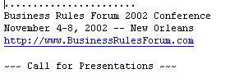
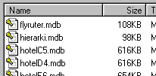

22. Function presentation
1 Now we know all the functions, including the navigation functions. It is time to find out how to show them on the screen. Here are some presentation formats that are available on most software platforms (section 7.8 discusses more possibilities).
2 Each of these formats look slightly different on the platforms. A button is for instance rounded on a Mac, rectangular on MS-Windows, a hyper-link or a fancy design on a web-site. This has little influence on our design, however. The important thing is that all buttons are labeled with a text suggesting what the button does.
Should we choose buttons, icons, or what? It depends on the kind of users we have. The most important factor is that high-speed use must be mouse-free. This suggests function keys for all functions, but they take time to learn. How do we combine ease of learning with high-speed use?
Checkin F5
Buttons
Checkin
Buttons
Icons
Print confirmation F7
Change room F8
Cancel stay F9
Cancel booking Del
Menu points
Menu points
3 One solution is to use buttons and menu points where the corresponding short-cut keys are shown too. This allows the user to start mouse-based and gradually learn the short-cut keys. He will for instance find out that he doesn’t need to click the checkin button but can use F5 instead.
Clicking on
texts, etc.
4 Buttons, however, occupy much screen space. Menu points occupy little space, but are hard to see for the beginner. What about icons?
5 No good in our case. They are visible and occupy little space, but they are rarely intuitive to understand, and they don’t help the user learn the short-cuts. However, they may look nice!
Function keys, e.g.
F2, Esc, Enter, Alt+B

Slide 23
23. Hotel system, mockup prototype
1 The discussion of function presentation helps us decide how to show functions in the hotel system. We know that receptionists become very experienced and fast-working, but there are also temporary staff who have to learn.
Conclusion: Use buttons and menu points. There are many functions, so they can not all be buttons since that would take too much screen space. Show the most frequently used functions as buttons, the rarely used ones as menu points. We are now able to make a prototype of the user interface. Here is part of a prototype for the hotel.
2 This prototype is a paper mockup. The final system will be in MS-Access, so the functions are drawn that way. We print the screens on paper, copy them and fill them out with various data. We draw the menus on separate slips.
With such a mockup, we are able to let a user carry out various tasks - with the designer simulating what the computer would do. We can find most usability problems in this way. Chapters 2 and 13 tell more on this.
Hotel system
Rooms Breakfast Services Undo
Open service list
Add service
Delete service
Print service list
Find guest
Search guest from
Name (any) Stay No. (any)
Phone (any) Room No. (any)
Date 28-08-2002
Find guest F2
New guest F5
Find stay F3
New stay F6
Reset F4
Open stay F4
Guest Phone Arrival Room# Stay#
John Simpson, 456 Orange 94213700 28-08-2002 12 714
Lise Hansen, Dyssegaards 39561748 28-08-2002 12 753
Yun Chen, Kirchgasse 6 28-08-2002 13, 14 749

Slide 24
Hotel system, final system
1 Letting the user carry out tasks on his own is called a usability test. We observe the problems the user encounters (the usability problems). In the hotel case, usability tests revealed many problems that were not detected when testing the virtual windows for understandability:
1. In the FindGuest window, the user didn’t realize that the name criterion could be any part of the guest name.
2. The user needed to see whether the guest was checked in or just booked.
3. The stay numbers were more convenient as the first column of the table.
. . . And many more problems.
2 At the mockup stage, it was easy to change the design and usability test it again. When the result is good enough, it is time to program the system. Here is a first version of the final FindGuest window with these three problems repaired. Note how closely the final window follows the mockup. Chapter 8 reports on the many other problems and how they were handled (a few seemed impossible to repair).
3 Does it take more time to ensure good usability? A company that makes professional sound-measure-ment equipment (Bruel & Kjaer), tried to use early prototyping and usability testing. They found that it made development simpler and faster.
4 Developers now knew exactly what the user interface would be and how the system should work. The rest was “just” programming according to the book. Furthermore they sold twice as many units of the product and at twice the usual price.
Since then, the appraoch has worked equally well in many other cases, including web-sites and mobile systems.

Slide 25
Object-oriented development?
1 In 2005 when the book was written, many developers and researchers claimed that object-oriented analysis and design (OO) was the panacea for all software evils. Unfortunately, it remained obscure how the user interface came out of the analysis and design. Nobody showed a real user interface made this way.
Is our user interface approach object-oriented? Yes, in some ways. Let us look at it in the OO way.
3 Functions = Object operations. When we have defined the virtual windows, we add functions to each window. This is similar to how designers add operations (methods) to the classes.
4 Data presentation first, dialog later.
While other user interface design methods look at dialog and functions first, and data presentation later, we say that it does not make sense to define the functions until we know the data presentation, i.e. the virtual windows. In OO-terms it should not be a surprise - of course we cannot define the object operations until we know the objects.
In OO-terms there is another surprise, however. We can not derive the functions directly from a study of the domain (the analysis). The functions the users carry out do not transfer in a simple manner to the user interface. We need the virtual windows as an intermediate step. It does not make sense to assign the user interface functionality to the traditional static class model of the system.
2 Virtual windows = user-oriented classes. The virtual windows correspond to classes in OO. But they focus on presenting the data contents in a user-oriented way. A virtual window may have many instances - many objects - for instance many Stay windows.
With virtual windows we pay great attention to an early graphical design of the “class”. Compared to traditional classes, the windows also have much redundancy since the same data may be shown in many windows (although we try to minimize it). Finally, we arrive at the proper set of windows from a close study of both the user tasks and a traditional static class model (a data model).

Slide 26
Object-oriented development
4 Use cases = tasks? OO-designers talk about a use case as the interaction between a system and its user to reach some goal. In principle, it is similar to the user tasks we talk about.
However, in practice the typical use case describes the detailed interaction, and primarily the computer’s part of it. If you try to define such use cases early on (and many developers do so), you have defined the user dialog and the user functions much too early. The result is a poor user interface. The virtual windows are needed as an intermediate step.
When we talk about tasks, we look at user and computer as one single agent and see what they must do together. Only late in the design do we split the work between user and computer. In this way we can use the tasks as guides for defining the virtual windows, and later as guides for defining the interface functions.
When we have defined virtual windows and their functions, we can write down the detailed use cases, for instance for checking purposes, but it is hardly worthwhile.
5 Screens = Objects with multiple inheritance. When we transform the virtual windows into final screens, we essentially define new objects - the screens. They inherit data and functions from the virtual windows they show. We also add some new operations to the screens - the navigation functions that allow the user to move between screens.
6 Interface objects = program objects? In the final interface, screens, fields, buttons, etc. may appear more or less directly in the program as objects. It depends heavily on the platform used.
As an example, in MS-Access or MS-Forms, each screen is actually an object (a “Form”). Fields and buttons, however, are in some ways small objects of their own (controls) - with their own set of micro-level functions that respond to actions such as clicking, entering a character, etc. Much of the mini-specs become program pieces in these functions.
Some complex program parts may become classes without direct connection to any virtual window. This is where traditional object-oriented programming plays a significant role.
Continue with task and data description
End of presentation

Slide 27
Task descriptions
1 There are many ways to describe tasks. Here is a simple task list with some annotation for each task. It is a good idea to write down any particular problems in the way the task is done at present - and maybe record possible solutions.
Task list
1. Reception
1.1 Booking. May involve many rooms.
1.2 Checkin. Some guests have booked in advance, some not.
1.3 Checkout. Review account, then invoice.
Problem: Checkout queue in the morning.
Solution? Self-service checkout.
1.4 Change room. Possible any time during the stay.
1.5 Breakfast list & other services. Breakfast list daily, service notes at any time.
2 Here is a more detailed description of the check-in task. We have broken it into sub-tasks. These sub-tasks describe what human and computer will do together. Only during the design process do we find out who does what. It is best to write such task descriptions together with expert users. They can readily understand the descriptions.
Task: 1.2 Checkin
Start: A guest arrives.
End: The guest has got room and key.
Accounting started.
Frequency: Average 0.5 checkins/room/day
Difficult: A bus with 50 guests arrives.
Sub-tasks:
1. Find room
Problem: Guest wants two neighbor rooms
1a. No suitable room.
1b. Guest has booked in advance.
2. Record guest data.
2a. Guest recorded at booking.
2b. Regular customer.
3. Record that guest is checked in.
4. Deliver key.
3 We have enumerated the sub-tasks for reference purposes, but the sub-tasks need not be carried out in this sequence. In some cases it is for instance convenient to record the guest data before selecting a room for him.
Note that a sub-task can have variants. If the guest hasn’t booked and is not in the files, the receptionist records him (sub-task 2). If he has booked, the receptionist will find his booking data (variant 2a).
Sections 5.3 to 5.6 of the book explain more on task descriptions.
Return to course

Slide 28
Data descriptions
1 Here is a compact description of the hotel data in the form of an E/R (entity-relationship) data model. Each box symbolizes a file card. Behind the box is a pile of similar file cards. The guest box, for instance, has a card for each guest that the hotel wants to keep track of. The crows foot to Stay shows that each guest may have one or more recorded stays. The attributes for each box are shown too. For the guest, for instance, we record name, several address lines, a phone number, and a passport number (foreigners only).
name,
address1,
address2,
address3,
phone,
passport
Guest
name, price
Stay
Service
Service
Type
stayID,
paymethod,
state (book | in | out)
Room
State
date, count
date, personCount,
state (booked | occupied | repair)
roomID,
bedCount, type
price1, price2
Room
2 Expert users can easily understand E/R models, and they are an excellent tool for the IT professional. Traditionally they were primarily used for business applications, but today they are used for all kinds of applications. Amazingly, few people are able to make an E/R model.
Class: Guest
The guest is the person or company who has to pay the bill.
Examples
1. A guest who stays one night.
2. A company with employees staying now and then,
each of them with his own stay record where his
name is recorded.
3. A guest with several rooms within the same stay.
Attributes
name: Text, 50 chars . . .
passport: Text, 12 chars
    Recorded for guests who are obviously foreigners. Used for police reports in case the guest doesn’t pay . . .
Data dictionary
3 E/R models lack the soft information often necessary for design. Data dictionaries can be a good supplement, such as this one for the guest. Expert users can readily help the designer make the data dictionary.
Chapter 16 of the book explains more on data modeling and data descriptions.
Return to course

